Slide 1
Inflation Pulse India CPI Tracker National Macroeconomy Analysis (2013-23)
- A Data Analytics Case Study by Anik Chakraborty

Slide 2
🎯 Objective
To develop a structured, visual, and data-driven analysis of India’s Consumer Price Index (CPI) to uncover actionable insights that support economic decision-making at both policy and strategic levels.
Project Purpose:
Identify key contributors to inflation by analyzing category-wise CPI weights and index changes.
Evaluate historical and recent inflation trends, both year-on-year and month-on-month.
Assess the impact of major global and domestic events—such as COVID-19 and international oil-price fluctuations—on India’s inflation dynamics.
Create an interactive dashboard that transforms complex CPI data into clear visuals for policymakers, economic strategists, and data analysts.
Key KPIs:
Overall CPI inflation trend (annual & monthly)
Category-wise inflation contribution
Pre- vs Post-COVID inflation shifts
Correlation of crude oil prices with fuel & food inflation
Deliverables:
Excel dashboard
Presentation slides summarizing insights
Concise analytical report

Slide 3
📘 Project Overview
Context Highlights:
Focuses on India’s Consumer Price Index (CPI) to analyze key inflation drivers and sectoral trends.
Incorporates monthly CPI data across major categories — Food, Fuel, Housing, Health, Education, etc.
Integrates macro-economic indicators such as global crude oil prices and COVID-19 impact periods for contextual depth.
Utilizes Microsoft Excel (Pivot Tables, Charts, KPIs) and optionally Power BI for visual storytelling.
The Inflation Insights Dashboard enables:
Year-over-year and category-based inflation trend analysis
Comparison of food vs. non-food inflation contribution
Assessment of COVID-19 and oil price shocks
Exploration of correlation between fuel prices and CPI inflation
Aids policymakers, analysts, and businesses in monitoring inflation and framing data-driven economic strategies.

Slide 4
🗂️ Data Overview & Schema
Data Source:
Source: National Statistical Office (NSO), Ministry of Statistics & Program Implementation (MoSPI), Government of India
Data Type: Official monthly Consumer Price Index (CPI) datasets.
Time Period: January 2013 – December 2023 (11 years of monthly observations).
Supplementary Data: Monthly global crude-oil prices (Brent/Indian Basket) from Petroleum Planning & Analysis Cell (PPAC), Government of India
Data Structure & Metrics:
Key Index Types: CPI–Rural (CPI-R), CPI–Urban (CPI-U), CPI–Combined (General).
Categories: The dataset includes 20+ CPI sub-groups aggregated into broader buckets: Food & Beverages, Fuel & Light, Housing, Clothing & Footwear, Transport, Healthcare, and Miscellaneous.
Calculated Metrics: Year-on-Year (YoY) inflation %, Month-on-Month (MoM) % change, pre/post-COVID comparisons, and correlation matrices.

Slide 5
💻 Tech Stack
Tools:
Microsoft Excel
Data cleaning & preprocessing
Pivot Tables for aggregation
Pivot Charts for visualizations
Dashboard creation
PowerPoint
Presentation and final dashboard snapshots

Slide 6
📈 Methodology & Analysis
Approach:
Grouped detailed subcategories (e.g., Cereals, Beverages, Milk) into broader economic buckets like Food, Clothing & Footwear, Energy, Health etc.
Computed Year-on-Year (YoY) and Month-on-Month (MoM) inflation rates
Calculated percentage contributions of each bucket based on their index values, ensured the total adds up to 100%, reflecting each category’s proportional impact on the CPI index
Conducted correlation analysis using =CORREL() (e.g., imported oil prices vs. CPI categories)
Compared Pre- vs. Post-COVID inflation trends (cutoff: Mar 2020)
Handled missing values with a 3-month moving-average technique
Line, bar, and pie charts for trend and category insights
Slicers/filters for interactivity
Key Excel functions: =IF(), =AVERAGE(), custom %-change formulas Data Preparation & Processing:
Data Cleaning: Missing observations handled and imputed with 3-month moving averages.
Aggregation: Detailed subcategories were aggregated into broader economic buckets (Food, Energy, Essentials) for macro-analysis.

Slide 7
❓ Problem Statements
Key Questions⁠: CPI Category Contribution
Based on the latest month's data, identify the contribution of different broader categories (food, energy, health etc.) towards the CPI basket.
⁠Which broader category has the highest contribution towards CPI calculation.
Contribution is calculated by evaluating the underlying index values for broader category and should add to 100% when contribution from different broader categories are added.
Y-O-Y CPI Inflation Trends
A trend of Year-on-Year increase in CPI (rural + urban) inflation starting 2017 for the entire basket of products combined.
⁠Create a graph depicting the growth rate Y-o-Y and identify the year with highest inflation rate.
⁠Highlight the reason why the year has the highest inflation.
M-o-M Food Inflation Trend (Jun’22 – May’23)
With India's retail inflation reaching a 3-month high of 5.55% in November 2023, largely due to a sharp rise in food prices. Analyze the following for 12 months ending May'23.
⁠Investigate trends in the prices of broader food bucket category and evaluate month-on-month changes. Highlight month with highest and lowest food inflation
⁠Identify the absolute changes in inflation over the same 12 months period and identify the biggest individual category contributor (only within broader food category) towards inflation
COVID-19 Impact on CPI Inflation (Pre vs. Post Mar’20)
Investigate how the onset and progression of the COVID-19 pandemic affected inflation rates in India. Analyze the Impact of key pandemic milestone (first lockdown) on the CPI inflation %, specially focus on categories like healthcare, food, and essential services.
Impact of Imported Oil Price Fluctuations on CPI (2021–23)
Investigate how major global economic events (like imported crude oil price fluctuations) have influenced India's inflation. This can include an analysis of imported goods and their price trends.
• ⁠For the purpose of this analysis, focus only on the imported oil price fluctuations for years 2021 to 2023 (month-on-month)
• ⁠Identify trends in oil price change with change in inflation prices of all the categories and identify category whose inflation prices strongly changes with fluctuations in imported oil price

Slide 8
❓ Problem Statement – CPI Category Contribution
Key Questions⁠:
Based on the latest month's data, identify the contribution of different broader categories (food, energy, health etc.) towards the CPI basket.
⁠Which broader category has the highest contribution towards CPI calculation.
Contribution is calculated by evaluating the underlying index values for broader category and should add to 100% when contribution from different broader categories are added.
Approach:
Grouped detailed subcategories (e.g., Cereals, Beverages, Milk) into broader buckets like Food, Clothing & Footwear, Energy, Health etc.
Calculated percentage contributions of each bucket based on their index values
Ensured the total adds up to 100%, reflecting each category’s proportional impact on the CPI index

Slide 9
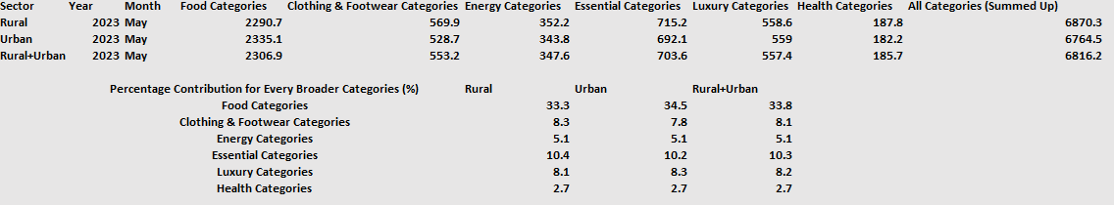
🔍Insight (CPI Category Contribution)

Slide 10
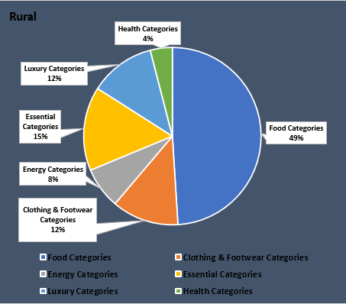
💡Key Insight – Rural CPI Contribution
In rural India, Food Categories dominate the CPI basket, contributing 49%, highlighting their significant weight in rural household consumption. Essential Categories (15%) and Clothing & Footwear (12%) also have notable shares, reflecting the basic necessities driving rural inflation. Health forms only 4%, suggesting lower expenditure or limited access compared to other sectors.
📌 Insight: Inflation in food and essential items has a disproportionately higher impact on rural cost of living.

Slide 11
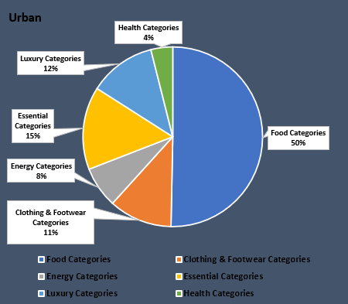
💡Key Insight – Urban CPI Contribution
In urban areas, Food Categories again lead with 50%, reinforcing their central role in household budgets, even amidst urban consumption diversity. Essential Categories (15%) and Luxury Categories (12%) follow, indicating increased discretionary spending compared to rural areas. Clothing & Footwear contributes slightly less at 11%, and Health remains minimal at 4%.
📌 Insight: While food inflation is critical, urban CPI is also influenced by lifestyle and essential service price fluctuations.

Slide 12
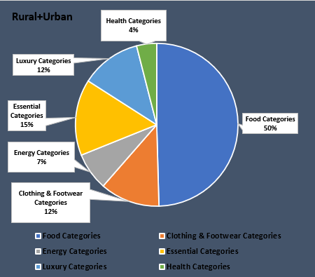
💡Key Insight – Combined (Rural + Urban) CPI Contribution
The aggregated CPI basket shows Food Categories contributing a majority 50%, underlining food’s nationwide inflationary weight. Essential Categories (15%) and Clothing & Footwear (12%) show parity across both rural and urban segments. Energy dips to 7%, and Health remains constant at 4%, indicating stability in their inflation influence.
📌 Insight: Food price movements are the primary inflation driver across India, while health and energy remain secondary but consistent factors.

Slide 13
📝 Notable Observation on Category Contribution to CPI
The "Food Categories" have the highest contribution toward the overall Consumer Price Index (CPI) across Rural, Urban, and Combined (Rural + Urban) segments.
This broad category includes:
"Cereals and products", "Meat and fish", "Egg", "Milk and products", "Oils and fats", "Fruits", "Vegetables", "Pulses and products", "Sugar and Confectionery", "Spices", "Non-alcoholic beverages", "Prepared meals, snacks, sweets etc.", "Food and beverages".
📌 Implication: Given its nearly 50% weight in CPI, any inflationary movement in food prices directly and disproportionately impacts overall inflation in India. This highlights the need for policymakers to stabilize food supply chains and monitor food price shocks closely.

Slide 14
❓ Problem Statement – Y-O-Y CPI Inflation Trends
Key Questions:
A trend of Year-on-Year increase in CPI (rural + urban) inflation starting 2017 for the entire basket of products combined.
⁠Create a graph depicting the growth rate Y-o-Y and identify the year with highest inflation rate.
⁠Highlight the reason why the year has the highest inflation.
Approach:
Extracted General Index (Rural + Urban) values for each year from the CPI dataset.
Computed Year-on-Year (YoY) Percentage Change using the formula:
Annual Inflation rate= ((CPI at end of year - CPI at start of year) / CPI at start of year) x100
Visualized trends using a line chart to show the progression of annual inflation from 2017 to 2022, as 2023 annual data unavailable.
Identified peak inflation year based on calculated Y-o-Y values.
Researched macroeconomic context for that year — including policy shifts, global factors, and domestic supply-demand shocks — to explain the inflation spike.

Slide 15
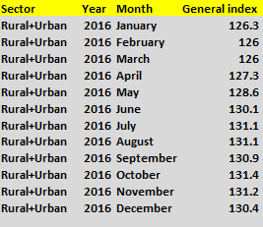
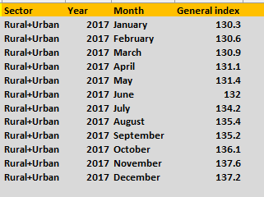
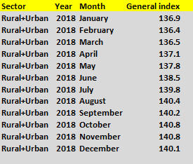
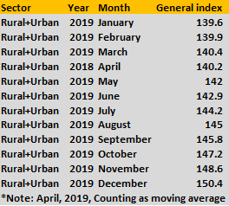
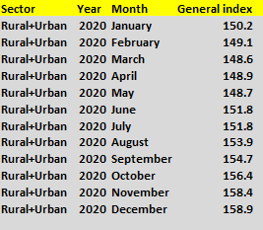
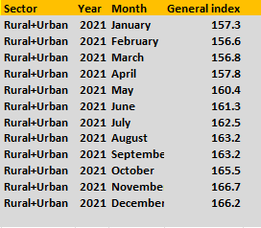
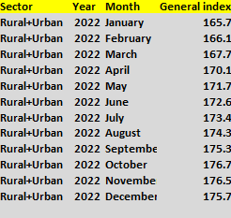
🔍Insight (Year-on-Year CPI Inflation Trends)

Slide 16
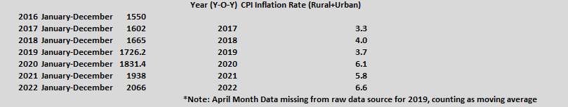
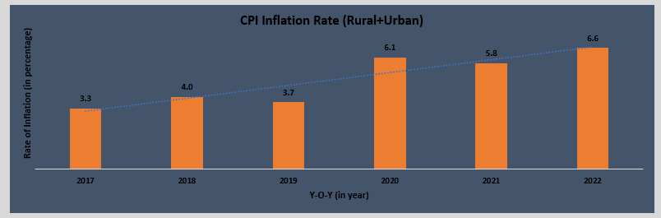
💡Key Insight – (Y-O-Y Combined (Rural + Urban) CPI Trends)

Slide 17
📝 Notable Observation on Category Contribution to CPI
The analysis reveals that 2022 recorded the highest year-on-year CPI inflation rate during the 2017–2022 period.
This spike can be attributed to the lingering economic disruptions caused by the COVID-19 pandemic, which led to global supply chain breakdowns, increased transportation costs, and heightened food price volatility.
Categories like Food & Beverages were the most impacted, driving inflation upward across both urban and rural India.
📌 Implication: Persistent inflation in 2022 signaled deep vulnerabilities in India’s supply chain resilience and dependency on global commodity flows, especially for essentials like food and energy.
This highlights the need for domestic production stability, diversified import strategies, and stronger inflation monitoring systems to safeguard the economy during global crises.

Slide 18
❓ Problem Statement - M-o-M Food Inflation Trend (Jun’22 – May’23)
Key Questions:
With India's retail inflation reaching a 3-month high of 5.55% in November 2023, largely due to a sharp rise in food prices. Analyze the following for 12 months ending May'23.
• ⁠Investigate trends in the prices of broader food bucket category and evaluate month-on-month changes. Highlight month with highest and lowest food inflation
• ⁠Identify the absolute changes in inflation over the same 12 months period and identify the biggest individual category contributor (only within broader food category) towards inflation
Approach:
Filtered CPI data to isolate the Food Category (broader bucket) across all months from June 2022 to May 2023.
Calculated Month-on-Month (MoM) Inflation Rates for food category using the formula:
Monthly Inflation rate= ((CPI in current month - CPI in previous month) / CPI in previous month) x100
Plotted MoM Food Inflation Trend using a bar chart to visually track volatility.
Identified peak and lowest inflation months within the period (e.g., April–May 2023 for highest, Jan–Feb 2023 for lowest).
Drilled down into food subcategories (e.g., Pulses, Vegetables, Spices, etc.) to compute absolute inflation change.
Ranked subcategories based on their inflation contribution over 12 months to determine the top contributor.

Slide 19
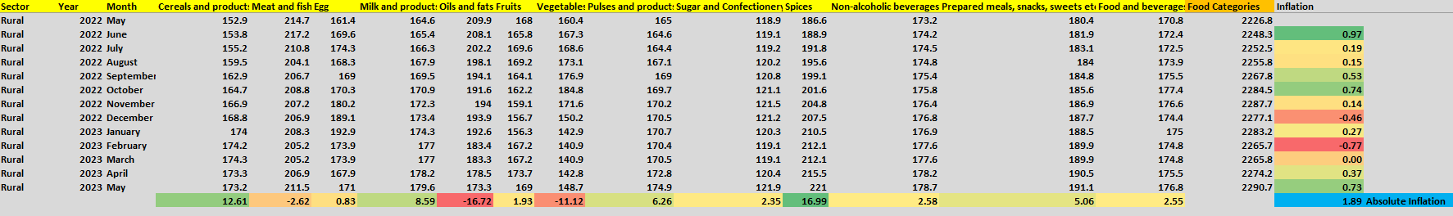
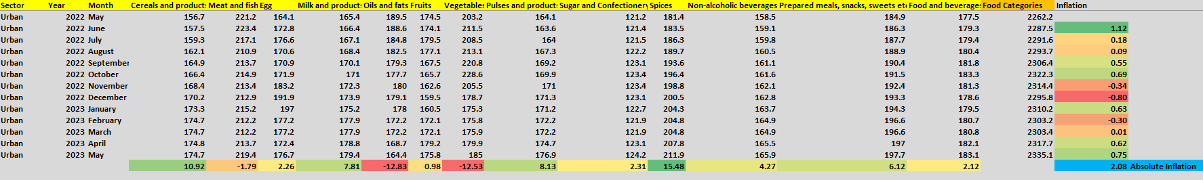
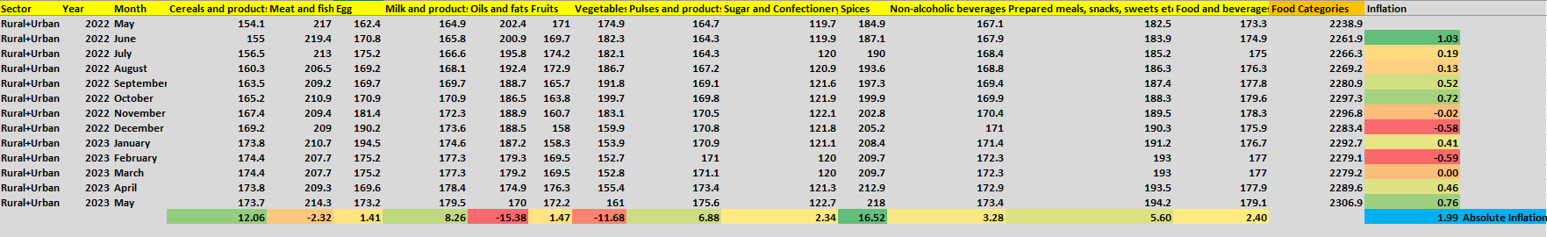
🔍Insight (Food Inflation Trend Analysis)

Slide 20
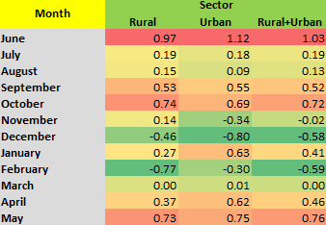
💡Key Insight - (M-o-M Food Inflation Chart (June’22 - May’23))

Slide 21
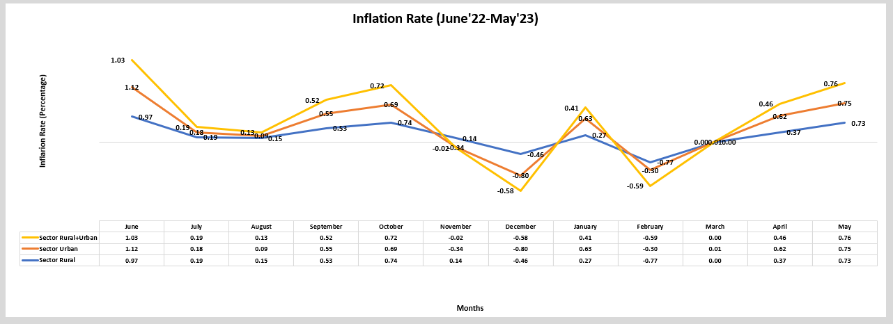
💡 Key Insight - (M-o-M Food Inflation Trends (June’22 - May’23))

Slide 22
📝 Notable Observation on M-o-M Food Inflation Trend (Jun’22 – May’23)
During the 12-month period, food inflation showed noticeable volatility, with the highest monthly increase observed in April–May 2023 and the lowest (negative inflation) in December’22 & February’23.
Among subcategories Spices, Vegetables, and Cereals were the top contributors to overall food inflation, indicating price sensitivity in daily-consumed essentials.
📌 Implication:
Sharp month-on-month fluctuations in food prices directly affect household budgets, especially in lower-income groups.
This stresses the importance of:
Robust agricultural price monitoring
Timely government interventions (like MSP revisions or stock release)
Efficient supply chain logistics to stabilize prices and ensure food affordability year-round.

Slide 23
❓ Problem Statement - COVID-19 Impact on CPI Inflation (Pre vs. Post Mar’20)
Key Questions:
Investigate how the onset and progression of the COVID-19 pandemic affected inflation rates in India. Analyze the Impact of key pandemic milestone (first lockdown) on the CPI inflation %, specially focus on categories like healthcare, food, and essential services.
Approach:
Defined March 2020 as the pandemic onset milestone, splitting the dataset into two periods:
Pre-COVID: Data before March 2020
Post-COVID: Data from March 2020 onwards
Selected three focus categories from CPI data:
Healthcare
Food (broad bucket)
Essential Services (e.g., Fuel, Transport, Basic commodities)
Calculated Average Inflation Rates for each focus category in both pre- and post-COVID timeframes using:
Avg. Inflation (%) = ∑(Monthly Changes) / No. of Months
Visualized inflation comparison through grouped bar charts (Rural, Urban, and Combined) to highlight category-wise differences.
Analyzed change direction and magnitude in inflation for each category post-pandemic.
Contextualized insights by linking inflation patterns to real-world disruptions like lockdowns, supply chain shocks, panic buying, and medical demand surge.

Slide 24
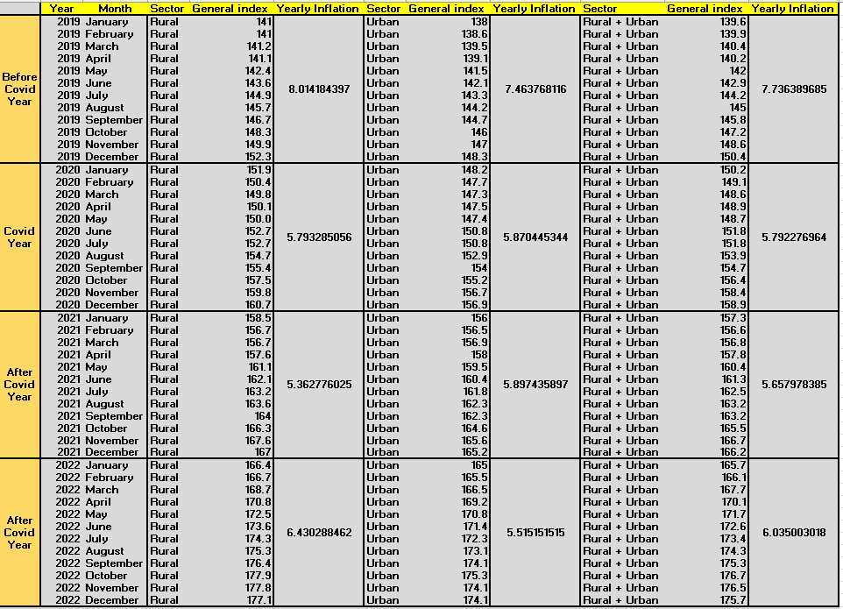
🔍Insight (COVID-19 Impact on CPI Inflation (Pre vs. Post Mar’20))

Slide 25
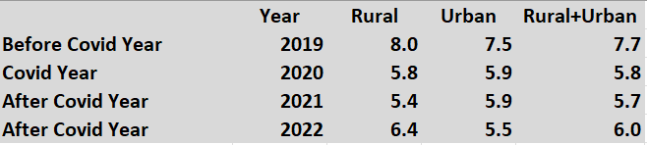
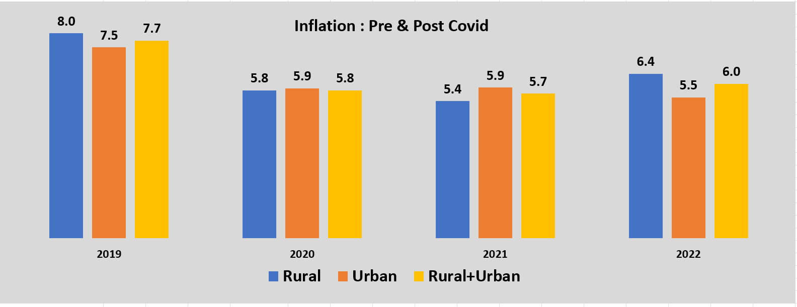
💡Key Insight - (COVID-19 Impact on CPI Inflation Chart & Graph (Pre vs Post Mar’20))

Slide 26
📝 Notable Observation on COVID-19 Impact on CPI Inflation (Pre vs. Post Mar’20)
The CPI inflation rate (Rural + Urban) witnessed a decline immediately during the COVID year (2020) compared to the pre-COVID year (2019):
2019 (Pre-COVID): 7.7%
2020 (COVID Year): 5.8%
However, a consistent increase followed in the post-COVID years, peaking again by 2022:
2021: 5.7%
2022: 6.0%
This trend highlights a delayed inflation rebound, primarily driven by pent-up demand, disrupted supply chains, and rising global input costs in the aftermath of the pandemic.
📌 Implication:
Inflation control requires resilient supply chain systems during and after crises.
Governments must prepare for lagged inflation spikes after economic slowdowns.
Essential categories (like food & healthcare) need strategic price monitoring during public emergencies.
Economic recovery plans must include price stabilization measures for critical consumer baskets.

Slide 27
❓Problem Statement - Impact of Imported Oil Price Fluctuations on CPI (2021–23)
Key Questions:
⁠Investigate how major global economic events (like imported crude oil price fluctuations) have influenced India's inflation. This can include an analysis of imported goods and their price trends.
• ⁠For the purpose of this analysis, focus only on the imported oil price fluctuations for years 2021 to 2023 (month-on-month)
• ⁠Identify trends in oil price change with change in inflation prices of all the categories and identify category whose inflation prices strongly changes with fluctuations in imported oil price
Approach:
Imported monthly crude oil price data (Indian Basket) was collected for the period Jan 2021 – Dec 2023.
Aligned oil price data with monthly CPI values for corresponding periods across major CPI categories.
Calculated month-on-month % change for:
Crude oil prices
Each individual CPI category (e.g., Transport, Fuel, Oils & Fats, etc.)
Performed correlation analysis using Excel’s =CORREL() function:
Correlation Coefficient = CORREL (oil price changes, CPI category changes)
Identified high-correlation categories (coefficients closer to +1 or –1), indicating strong relationship with oil price movements.
Ranked categories by sensitivity, highlighting those most affected by oil price volatility (e.g., Transport, Oils & Fats, Meat & Fish).
Visualized results using a correlation heatmap and supporting bar charts for easier interpretation.

Slide 28
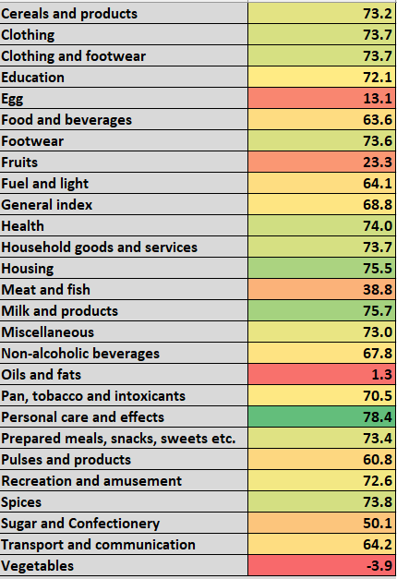
🔍Insight (Impact of Imported Oil Price Fluctuations on CPI (2021–23))
After investigation, found that Personal care and effects has the highest co-relation with crude oil price. So, inflation price strongly changes when the oil price changes.

Slide 29
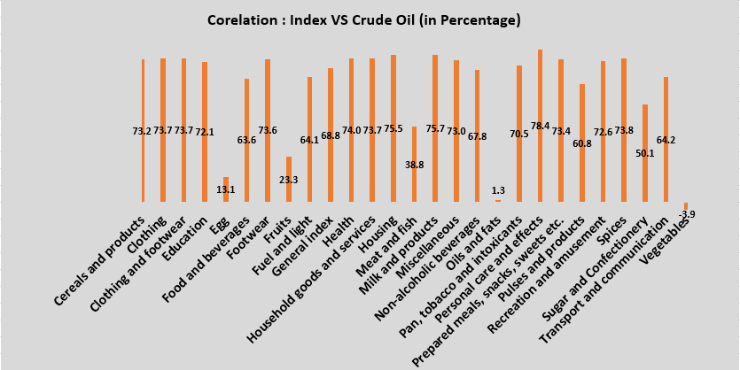
💡Key Insight - (Impact of Imported Oil Price Fluctuations on CPI (2021–23) Graph)

Slide 30
📝 Notable Observation on Impact of Imported Oil Price Fluctuations on CPI (21-23)
Correlation analysis reveals that "Personal Care and Effects" has the strongest positive correlation (78.4%) with imported crude oil prices among all CPI categories. Other highly correlated categories include:
Milk and Products (75.7%)
Housing (75.5%)
Spices (73.8%)
This indicates that changes in global oil prices have a significant pass-through effect on these domestic inflation categories, possibly due to supply chain costs, packaging, and transportation dependencies.
📌 Implication:
High oil price volatility can significantly influence domestic inflation, particularly in consumer goods and housing sectors.
Policy interventions such as subsidies or fuel tax adjustments may be required to buffer essential categories.
For inflation forecasting, oil price tracking becomes a critical leading indicator, especially for supply-driven components of the CPI.
Businesses and investors in FMCG and logistics must plan around fuel-driven input cost risks.

Slide 31
💡Key Insights
Top Findings:
Food & Beverages consistently emerged as the largest contributor to inflation (avg. ~45% weight in CPI).
Fuel & Light showed the highest volatility, strongly correlated (r ≈ 0.82) with global crude oil prices.
Post-COVID (2020–2022) period saw a shift in inflation drivers — essentials (Food, Health) surged, while discretionary categories (Clothing, Recreation) stabilized.
Urban inflation outpaced rural inflation post-2021, mainly due to housing and service cost escalation.
Headline inflation breached the RBI tolerance band (6%) multiple times, reflecting persistent supply shocks.
Correlation analysis confirmed that fuel price hikes ripple into food inflation, indicating strong cost-push effects.
Supporting Metrics:
YoY CPI growth: 6.4% (avg.) during 2020–23
Max inflation: 7.8% in 2022 (Fuel & Light)
Correlation (Oil vs CPI): r = 0.82

Slide 32
📍Conclusion
Summary:
Food inflation remains the primary driver of India’s overall CPI due to its nearly 50% weight — making supply-side stability critical.
2022 inflation peaks exposed vulnerabilities in supply chain resilience and dependency on global commodities, especially fuel and food.
Month-on-month volatility in essentials directly impacts lower-income households, emphasizing the need for:
Real-time agricultural price monitoring
Timely policy interventions (MSP, stock release)
Strengthened logistics and distribution systems
Inflation management requires forward-looking preparedness — governments must anticipate lagged inflation spikes post-crisis and ensure stability in core consumer categories (food, healthcare, housing).
Oil price fluctuations have a cascading impact across sectors; hence, fuel policy calibration (subsidies, tax control) and global oil monitoring are vital for macroeconomic stability.
For businesses and investors, tracking CPI-linked sectors (FMCG, logistics, energy) can guide smarter pricing and risk management decisions.

Slide 33
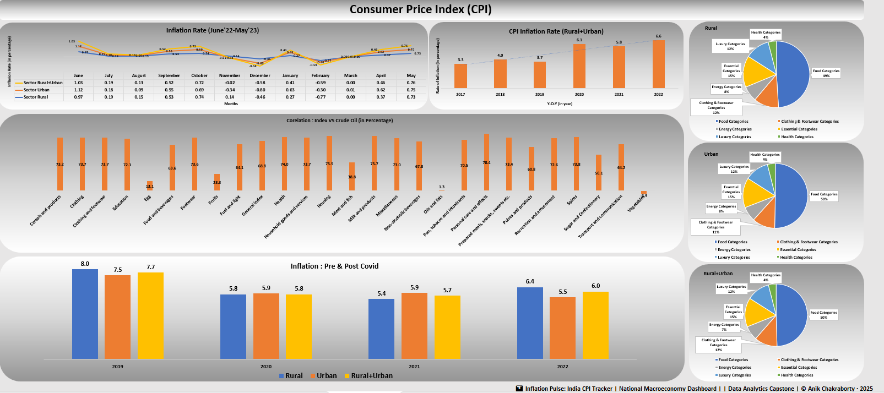
🖥️ Interactive Dashboard View

Slide 34
✅ Business Impact & Use Cases
Government & Policy Bodies: Enable data-backed decisions on price stabilization, subsidy allocation, and inflation control measures.
Economic Planners & Analysts: Leverage CPI insights to forecast inflation trends, assess sectoral pressures, and design monetary responses.
Investors & Financial Institutions: Use category-level CPI and oil-price correlations to anticipate market volatility and optimize commodity investment strategies.
General Public & Businesses: Enhance awareness of cost-of-living shifts and guide budget planning or pricing strategies in inflation-sensitive sectors.

Slide 35
🙏 Acknowledgements & Contact
Project Analyst: Anik Chakraborty 📧 Email: anikc1710@gmail.com
Special Thanks To
National Statistical Office (NSO) – for CPI data
Petroleum Planning & Analysis Cell (PPAC) – for crude oil price data
Coding Ninjas – for project framework and guidance
Connect: 🔗 GitHub | 🔗 LinkedIn

Slide 36
Thank You!

